Slide 1

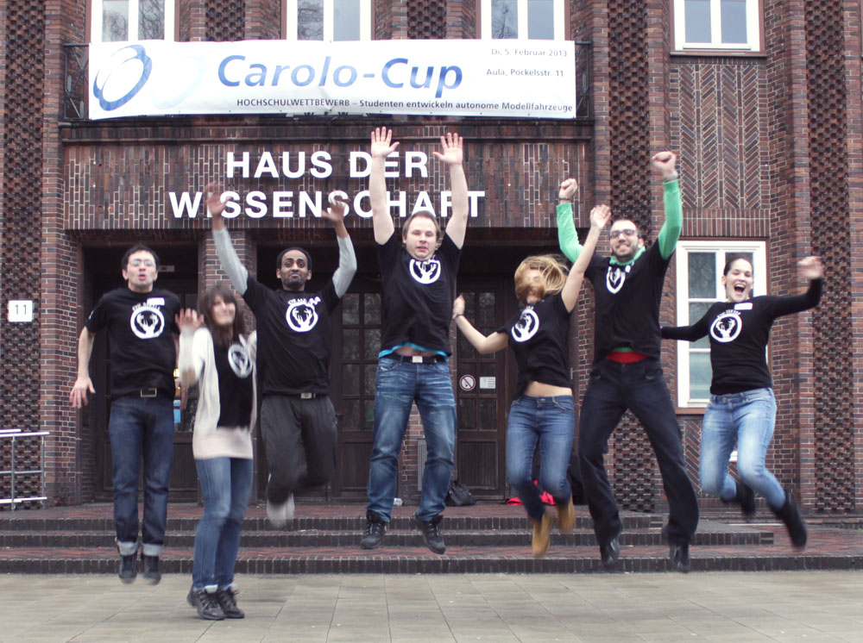
Notes:
New Picture with Benjamin
Team picture and logo change with effect

Slide 2
Outline
Hardware architecture
Software architecture
Lane following & control
Parking & control
Components’ purchasing costs
Energy efficiency
Conclusion

Slide 3
Hardware Architecture
Voltage Converter
Camera
Braking
LED Board
Ultra sonic rear
Ultra sonic front
Ultra sonic front/right
Flashing left
Main Board
(ARM Cortex™-A9)
Flashing right
11.1V / 3300 mAh
Sensor Board
Motor Controller
Emer-gency
Steer
Motor
Infra red rear
Infra red rear/right
Infra red front/right
Power
I²C
USB
RC receiver
PWM
UART
A-I/O
3bit con.
Notes:
Add Red Focus Circles : Ehsan
+Add car picture

Slide 4
Software Architecture
Image
Camera
Lane Following
Angle
Proxy
Force data
LED
Driver
Status data
Sensor board
Sensor board data
Motor Controller
UDP Server
HW
SW
Notes:
Status data (battery levels)

Slide 5
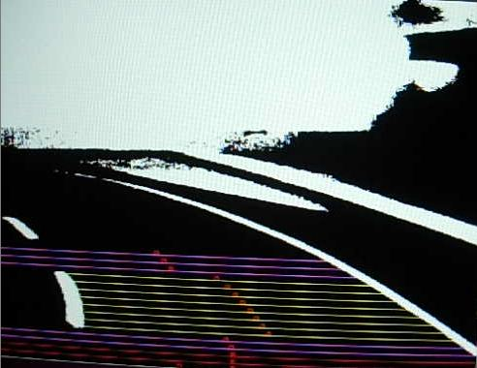
Lane Following
Finding features (lane markings & stop line)
Check feature quality or use previous data
Calculate required steering angle
Calculate lane’s skeleton line & derive desired adjustment angle
Calculate desired speed on required steering angle
Threshold
Lane markings
identification
Angle calculation & sliding window
Apply steering based on angle

Slide 6
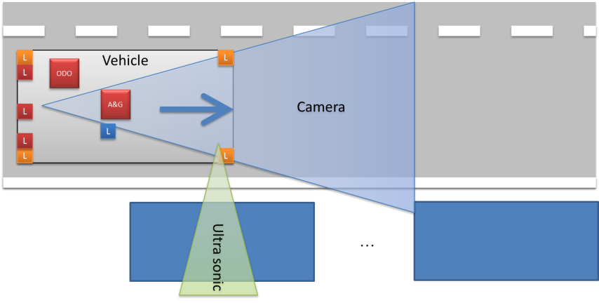
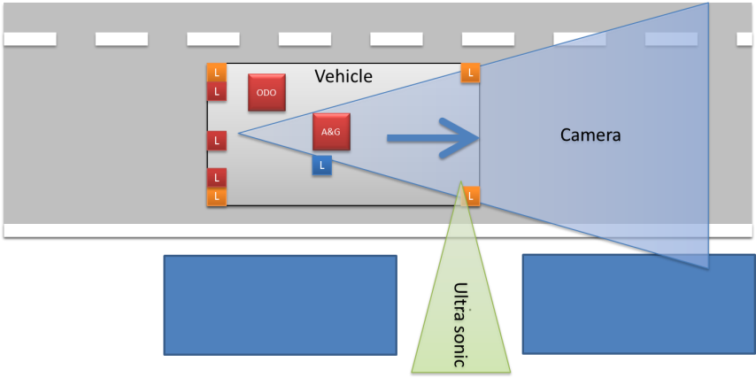
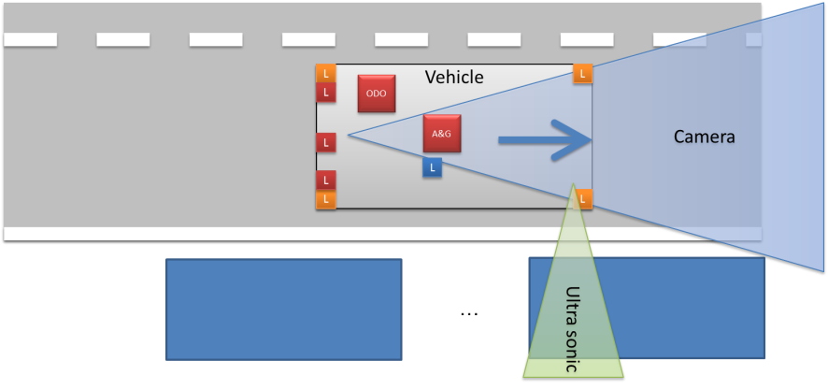
Parking
Measuring gaps
~0.2m
Identifying proper
parking spot using dead reckoning
>USclamp
Stop car and run parking trajectory
~0.19m
Notes:
Anna +Munir : Draft

Slide 7
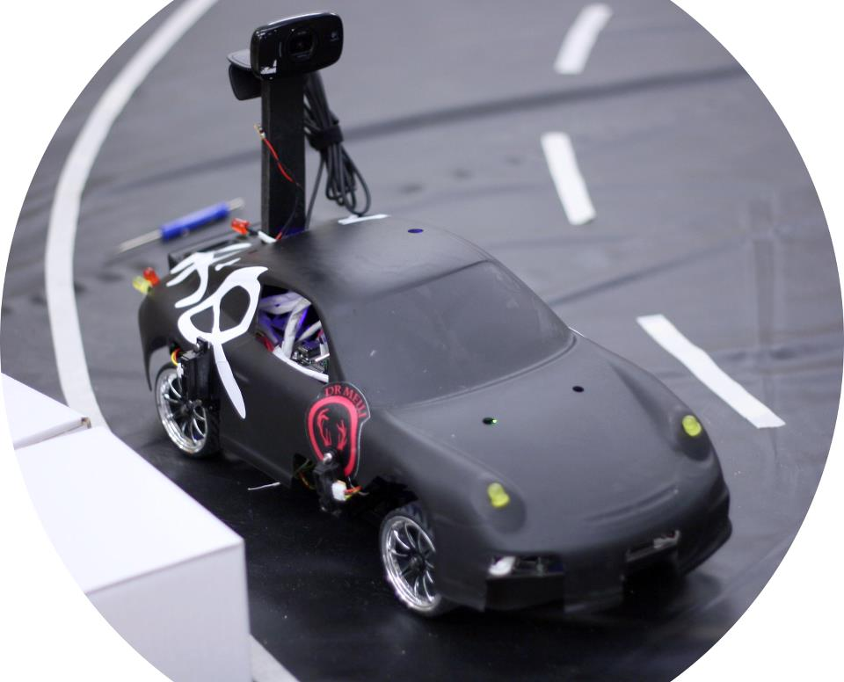
Purchasing Costs
Total; 1120 €
Notes:
Add absolute figures about the costs (name/total costs, e.g. “Vehicle: 250eur”

Slide 8
Energy Efficiency
Load
Driving
Accelerating
Idle
[W]
Low consumption hardware layout
Regenerative braking
Notes:
Lock anti-lock switching/synchronous switching

Slide 9
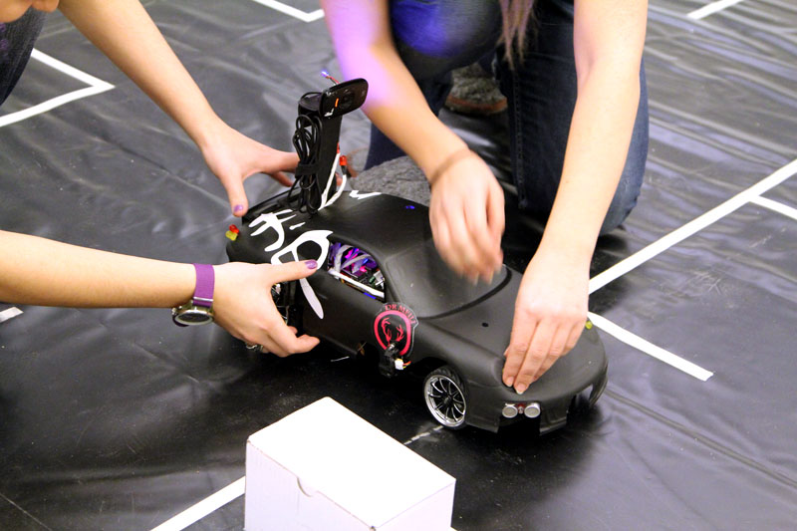
Conclusion
Lesson’s learnt:
Carolo Cup is a nice, motivating competition
Requires several disciplines to succeed
Simulation in the beginning help to understand concepts and problems
Outlook:
Change camera lens
Improve force- transmission system
Improve steering calculation

Slide 10
Thank You
Time for questions …

Slide 12
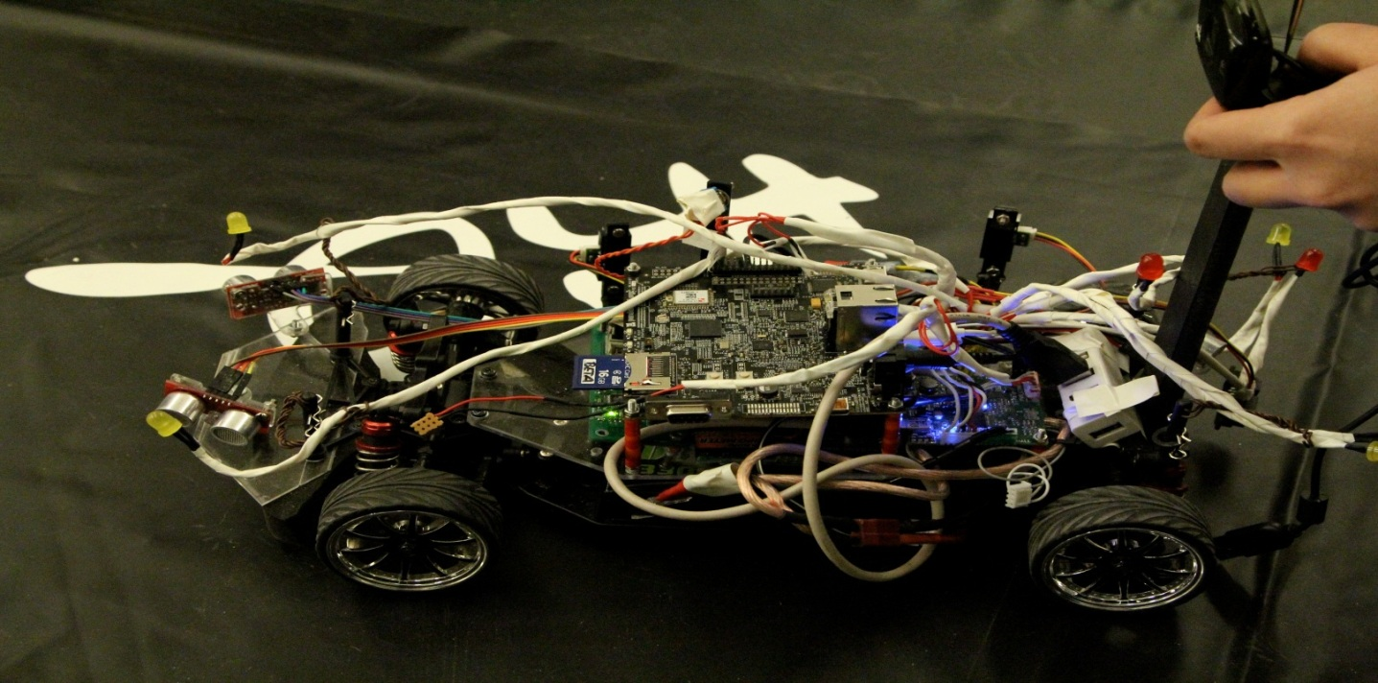
Regenerative braking
Conversion to electric energy: The motor as a generator

